Slide 1

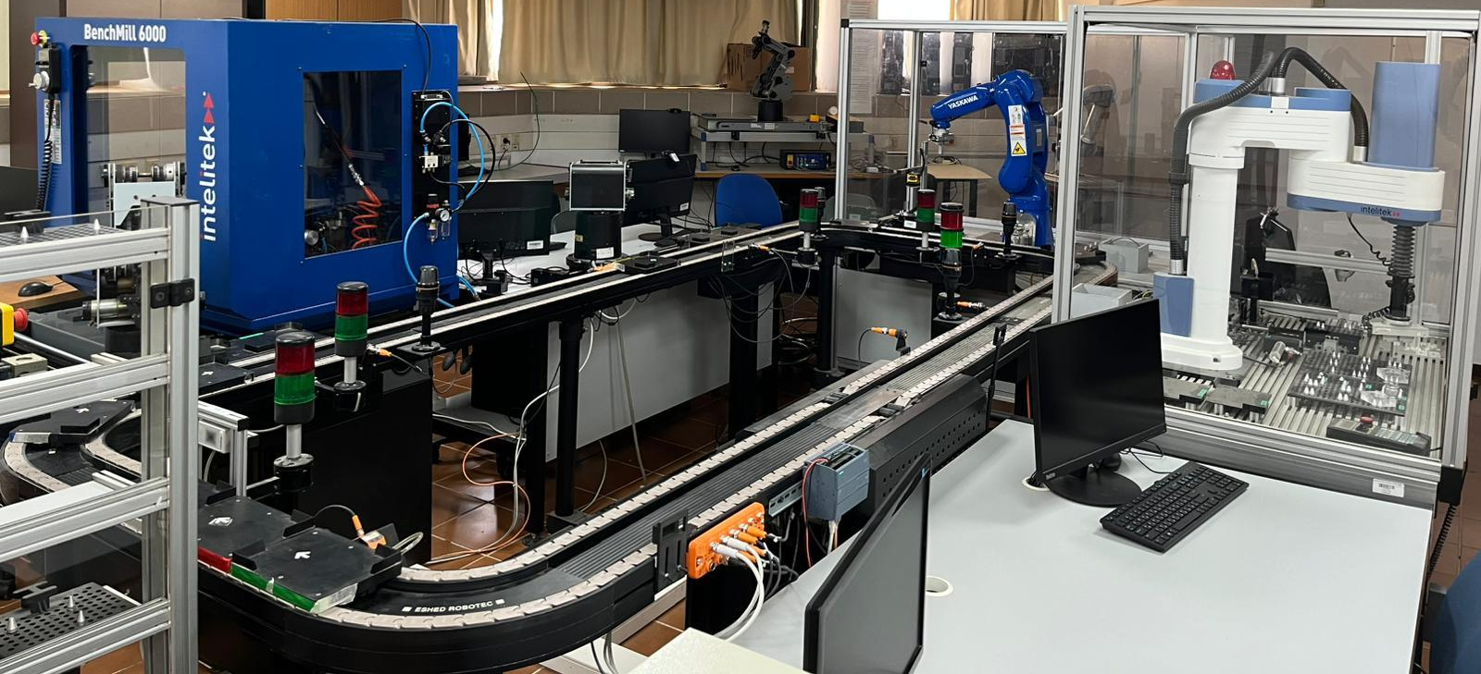
Production Line
Augmented Reality Application
By:
Shlomi Fridman
Shahar Berenson
Advisor:
Dr. Naomi Unkelos Shpigel

Slide 2
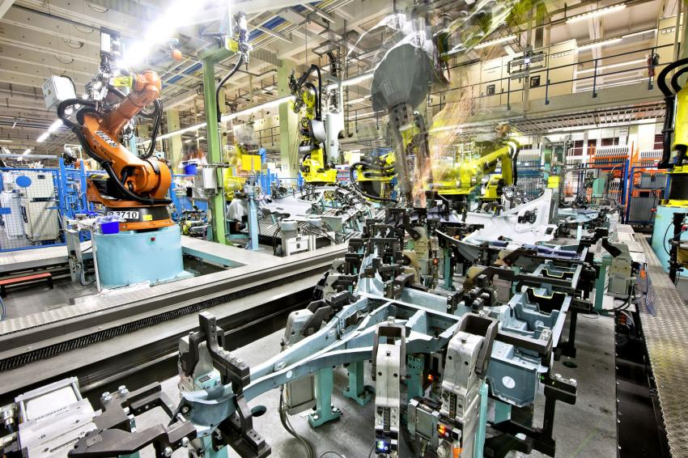
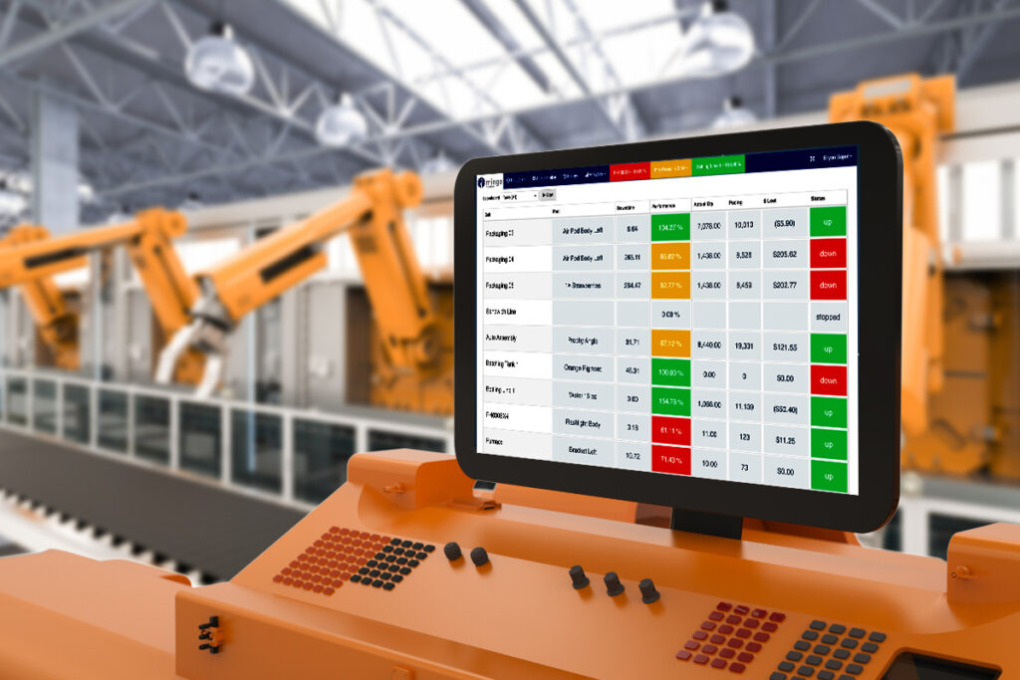
The Challenge
One challenge in modern industrial and educational settings, understanding production line operations can be a complex task. Especially for students and trainees unfamiliar with the underlying processes.
Another challenge is that educational staff are not always present on-site to monitor the complex production line. Faults in any of these components may go undetected and unresolved for hours or even days.
Notes:
Shlomi

Slide 3


Background
Augmented Reality (AR) For Monitoring - Enhances industrial monitoring by overlaying real-time data onto physical environments, improving fault detection, maintenance, and remote collaboration while reducing downtime and costs.[Syed 2022][Li 2024]
The Industrial Internet of Things (IIoT) - Revolutionizing manufacturing by boosting efficiency and data-driven operations, though its success depends on digital skills, strategic adaptation, and effective leadership.[Peter 2023]
Augmented Reality For IIoT - Integrating AR with IIoT enhances industrial operations by providing intuitive, real-time visualization and control of complex systems, though challenges like interoperability, scalability, and user adoption remain.[Fuentes 2024]
Notes:
Shahar

Slide 4
The Production Line (1/3)
The System was built by Eshed-Robotech at 1997.
The production line simulates automated actions:
Material handling
CNC milling machining
Robot-assisted assembly
Vision-based quality control
Storage & retrieval (AS/RS) system
The D106 lab is managed by Lab Engineer Daniel Wasserman.
Students and lecturers from the Mechanical Engineering and Industrial Engineering programs use the line to gain practical experience in modern production technologies, learning how real-world manufacturing processes work.
The CIM and Robotics Lab (Room D106) at Braude College
Notes:
Shahar

Slide 5
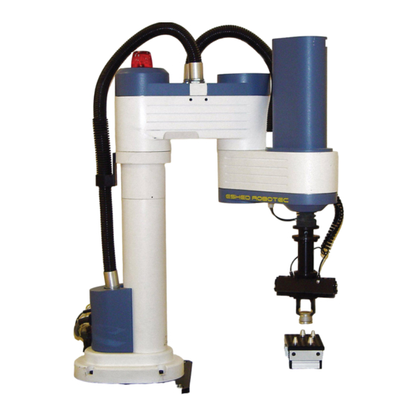
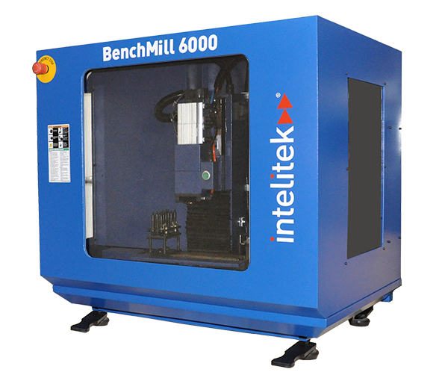
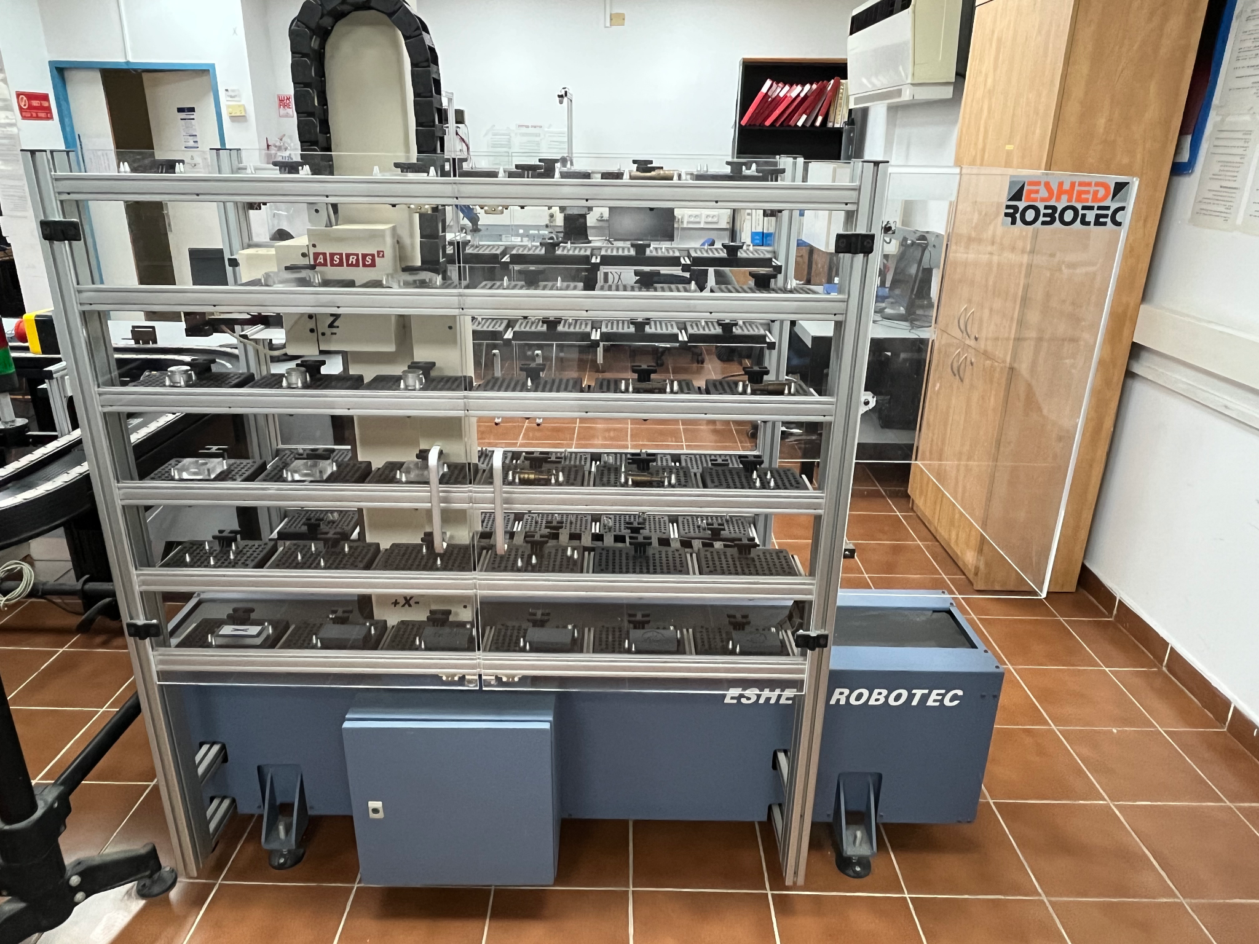
The Production Line (2/3)
The SCORBOT-ER V Plus responsible for retrieving the pallet and placing it in the designated working area.
The BenchMill 6000 is a milling machine used to teach and demonstrate automated precision machining
The Automated Storage Retrieval System (ASRS) 2 simulates a real-world automated warehouse system
Notes:
Shahar

Slide 6
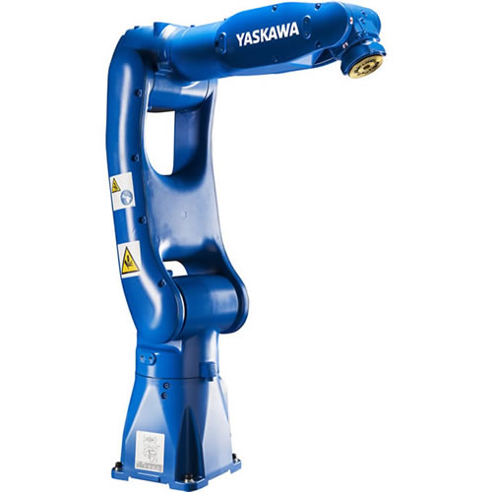
The Production Line (3/3)
The review station is operated by a Yaskawa Motoman robotic arm. If the part is marked with an "X", it is discarded; if marked with a "✓" it is returned to the cart within the CIM system.
The SCORA ER-14 is responsible for completing two distinct assembly plans. The tasks it does emphasize careful manual assembly and attention to detail to ensure functional and safe final products
Notes:
Shahar

Slide 7
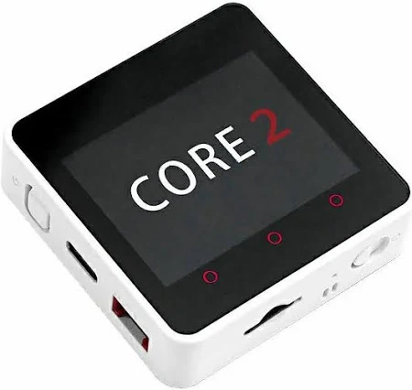
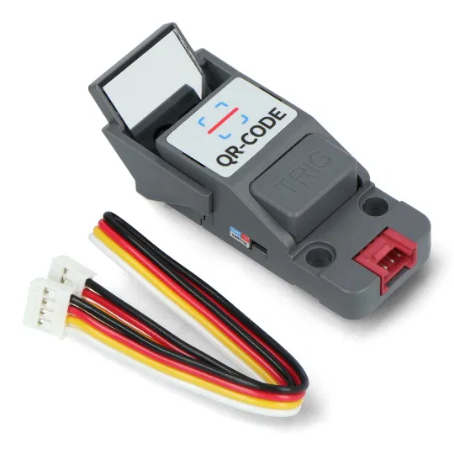
Monitoring Equipment
An M5 Stack controller is connected to a PaHub splitter, which is linked to four QR code sensors—one at each station. Each station is equipped with a QR-CODE TRIG sensor mounted on a stand, used to scan the QR code sticker on the cart to confirm its arrival at the station.
Notes:
Shahar

Slide 8
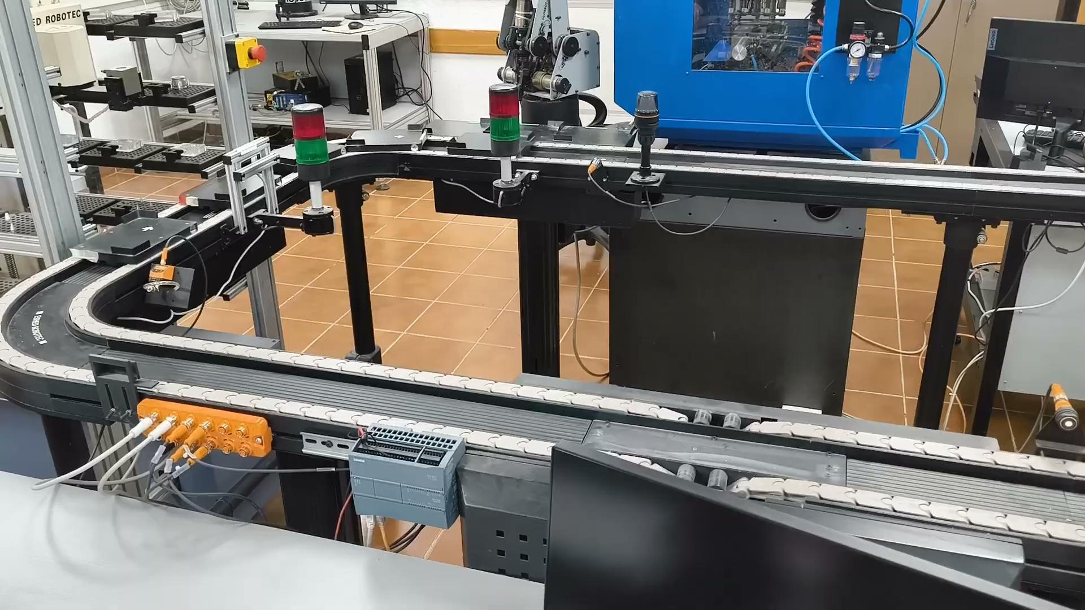
The Purpose Of The Application
The project aims to provide monitoring services and bridge the gap between industrial operations and educational training through an accessible, immersive augmented reality (AR) experience.
Notes:
Shahar
Cart Movement video

Slide 9
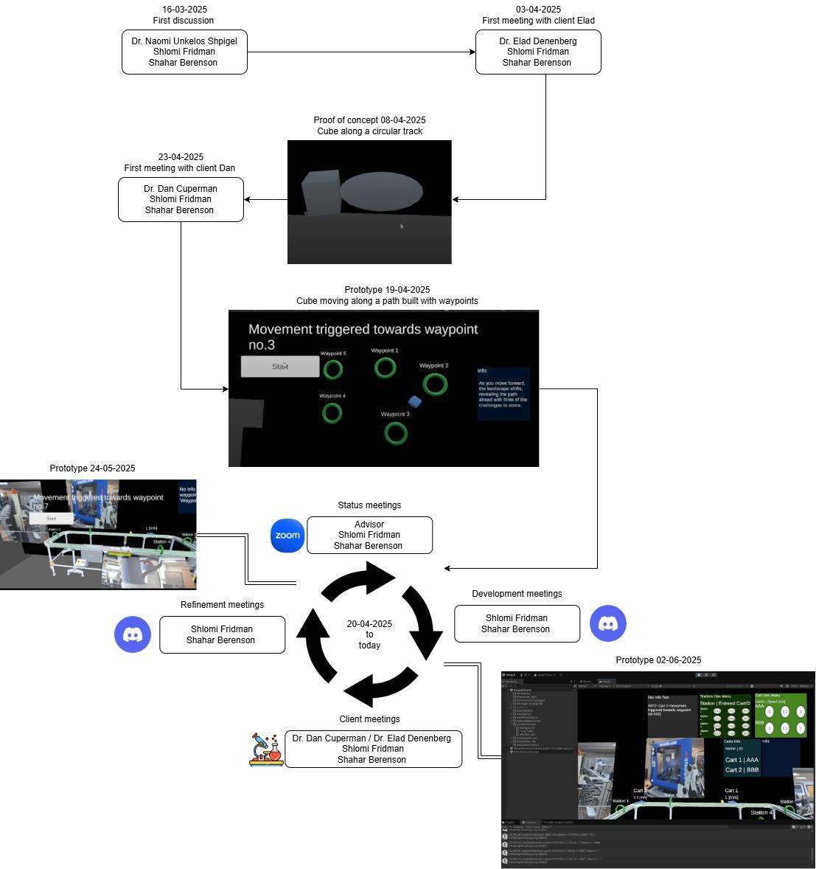
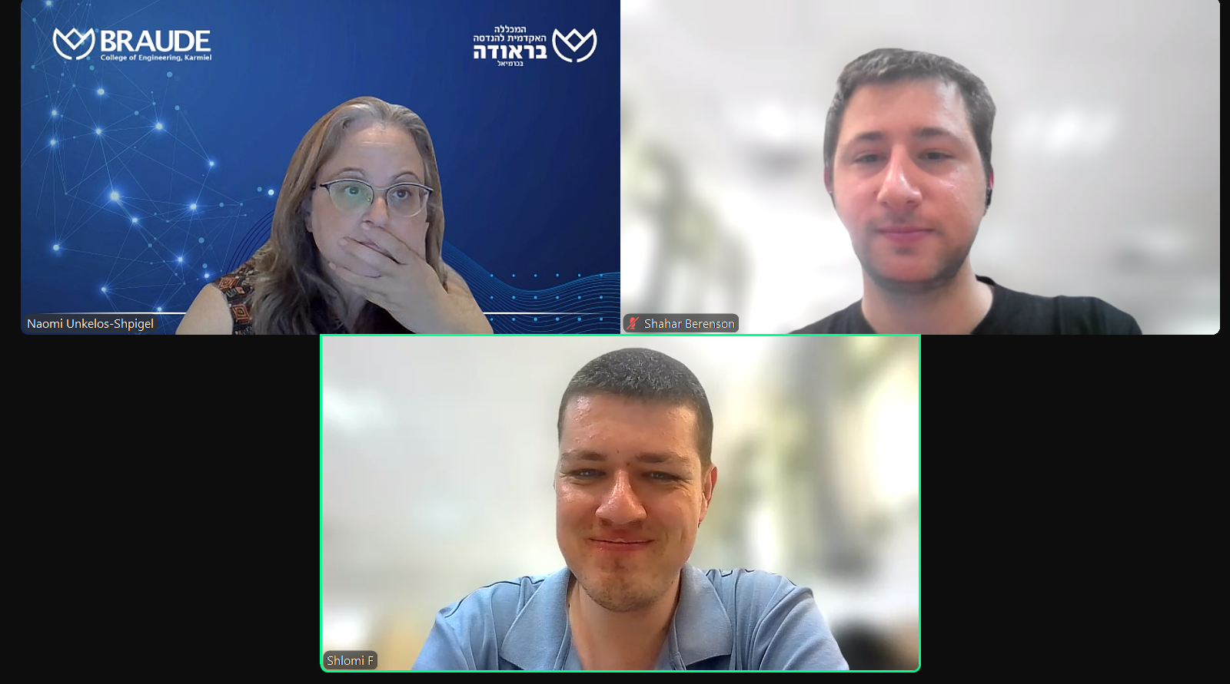
Engineering
process
Timeline
Status meeting

Slide 10
Functional Requirements
AR Visualization:
Render 3D models for carts and representations of the stations.
Show cart movement along predefined waypoints.
Production Line Representation:
Tap a station to view its description, image, or video.
The cart’s speed is displayed above the cart, in meters per second.
Tracking Logic:
Carts are tracked by ID and follow a waypoint path.
An expected\predicted time is calculated for when a cart is expected at its next station.
Alerts are displayed if a cart is late to a station.
Notes:
Shlomi

Slide 11
Non-Functional Requirements
Capacity: The system needs to support the four existing stations in the production line, i.e. display descriptions, images, etc.
Compatibility: Android 14 (API Level 34) or higher required.
Reliability:
Operate crash-free for at least 30 minutes under full load.
Graceful recovery from server disconnection.
Usability: Touchscreen-based intuitive UI.
Performance:
The QR-Code sensor sends updates whenever there is a change in the station occupancy.
Speed data updated every 10ms.
Prediction window accuracy: ±0.5 seconds.
Notes:
Shlomi

Slide 12
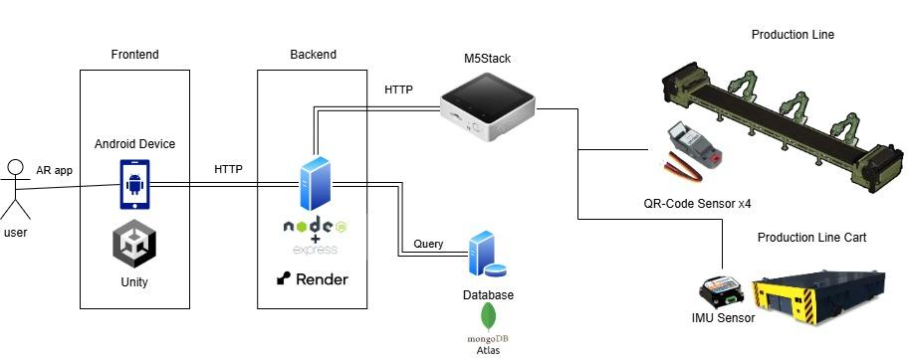
Architecture
Notes:
Shlomi

Slide 13
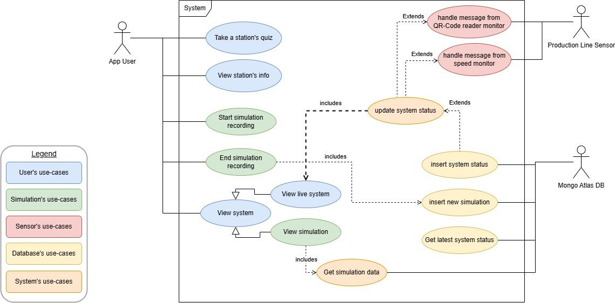
Use Case Diagram
Notes:
Shlomi

Slide 14
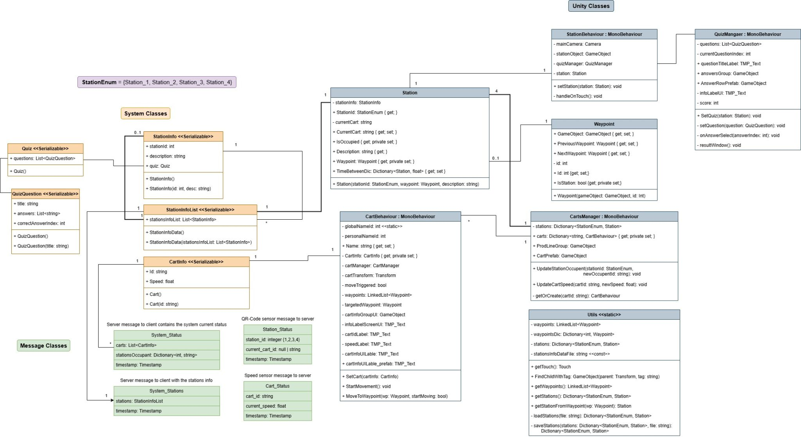
Class Diagram
Notes:
Shlomi
Be awed!!!

Slide 15
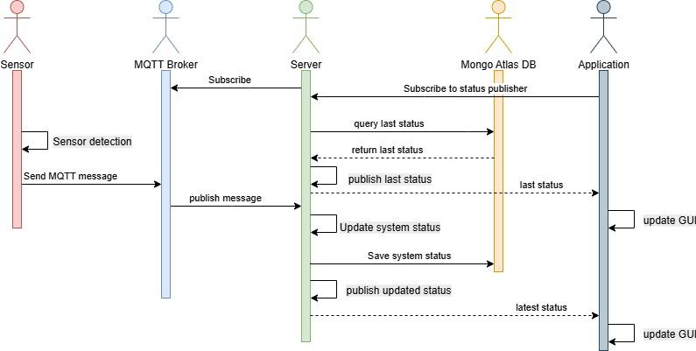
Sensor Data Sequence Diagram
Notes:
Shlomi

Slide 16
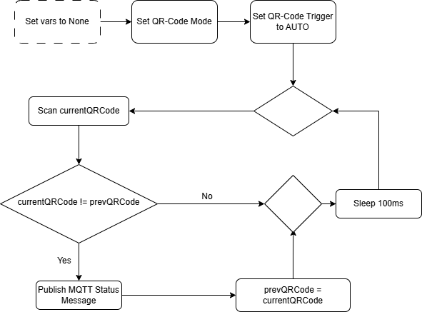
QR-Code Flowchart
Position
Notes:
Shahar

Slide 17
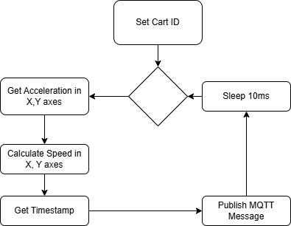
IMU Sensor Flowchart
Speed
Notes:
Shahar

Slide 18
Expected achievements
The primary outcome of this project is an augmented reality (AR) application deployed on the Vuforia platform. The application is designed to support two main user groups:
Lecturers \ Lab-Staff - Monitoring the production line by providing an interactive and visual representation of its real-time operation.
Students – An immersive and detailed visualization of each station and the flow of carts throughout the process.
The AR application will provide in-depth explanations for both teaching and learning. Additionally, a simulation feature will enable the user to study the operations even in the absence of live data.
Notes:
Shahar

Slide 19
KPI Metrics
User Experience:
Users are able to effectively monitor the production line in real time through the application, with accurate station status within 100ms of the real-time change.
The predicted arrival time of a cart at any station is accurate within a margin of ±0.5 seconds.
Performance:
The cart speed data is updated at intervals of 10 milliseconds.
The predicted arrival time of a cart at any station is accurate within a margin of ±0.5 seconds.
Availability & Reliability:
The application is compatible with Android devices running version 15 or higher.
The application remains stable and does not crash during continuous use for at least 30 minutes.
The application is capable of handling temporary server connection losses without crashing or losing data integrity, and reconnects to the server within 1 minute after the crash.
Notes:
Shahar

Slide 20
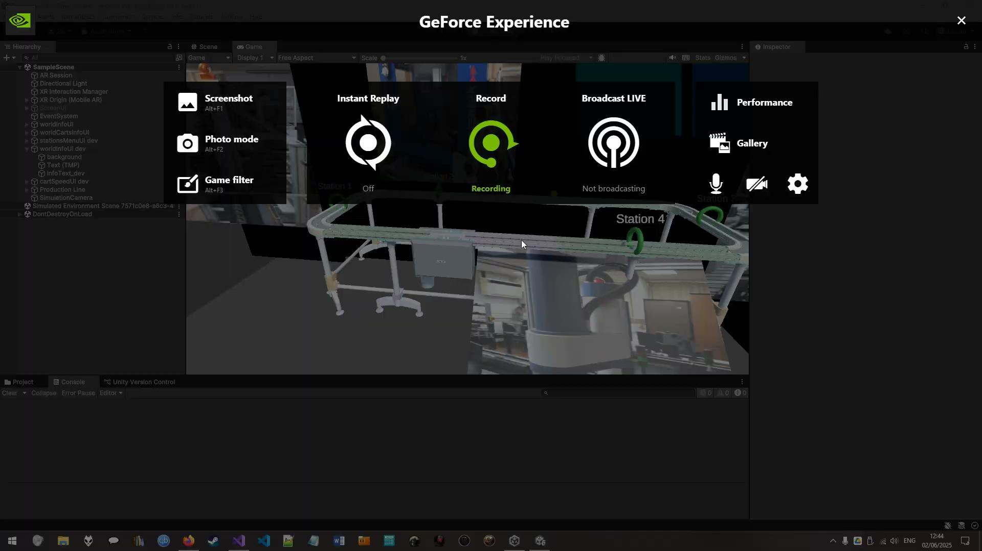
Prototype
Prototype 02-06-2025
In the absence of a real server, we focused on two main tests designed to provide a believable simulation and validate the client application's logic flow.
Cart movement:
Test: Is the cart movement an accurate representation of its real-world counterpart?
Result: The virtual cart's movement accurately simulates its real-world counterpart by following plotted waypoints on the virtual production line model.
Message handling:
Test: Can the client application effectively process simulated messages regarding cart speed and station occupancy?
Result: The prototype logic successfully handles the simulated messages, updating station statuses and cart movement speed with the provided data, thus creating a believable virtual environment.
Notes:
Shlomi

Slide 21
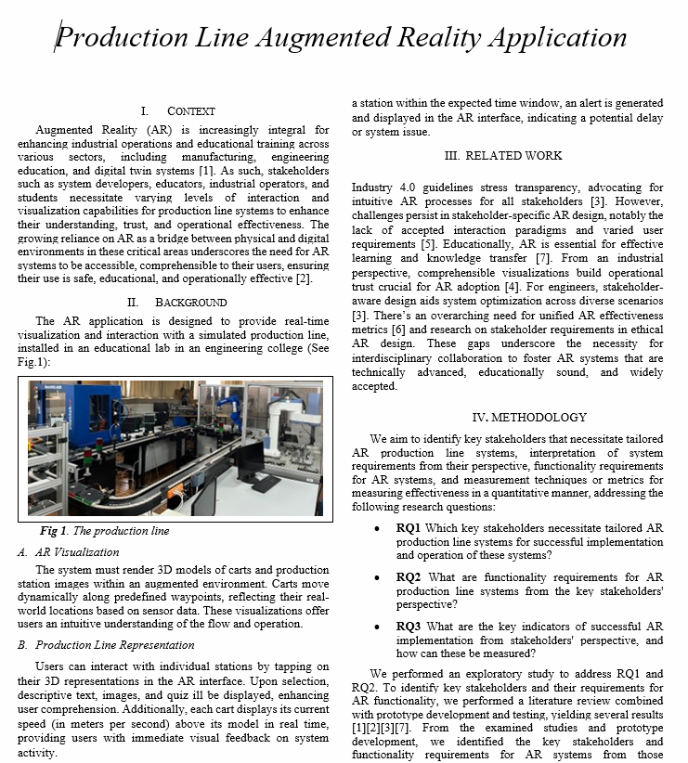

Prototype so far…
The prototype will be presented at Requirements Engineering 2025 conference in Valencia, Spain

Slide 22



